Slide 1
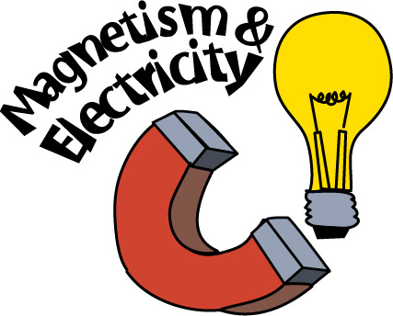

Slide 2
Electricity and Magnetism
8.2
Electric Current and Magnetism
In 1820, Han Christian Oersted, a Danish physics teacher, found that electricity and magnetism are related.
Oersted hypothesized that the electric current must produce a magnetic field around the wire, and the direction of the field changes with the direction of the current.

Slide 3
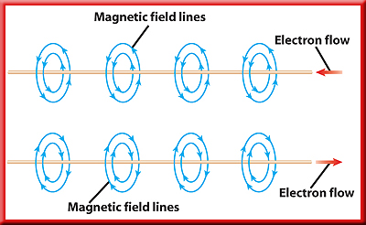
Electricity and Magnetism
8.2
Moving Charges and Magnetic Fields
It is now known that moving charges, like those in an electric current, produce magnetic fields.
Around a current-carrying wire the magnetic field lines form circles.

Slide 4
Electricity and Magnetism
8.2
Moving Charges and Magnetic Fields
The direction of the magnetic field around the wire reverses when the direction of the current in the wire reverses.
As the current in the wire increases the strength of the magnetic field increases.

Slide 5
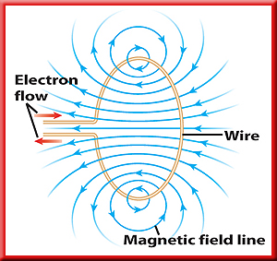
Electricity and Magnetism
8.2
Electromagnets
An electromagnet is a temporary magnet made by wrapping a wire coil carrying a current around an iron core.
When a current flows through a wire loop, the magnetic field inside the loop is stronger than the field around a straight wire.

Slide 6
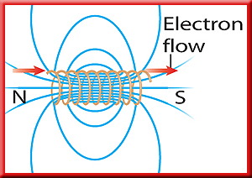
Electricity and Magnetism
8.2
Electromagnets
A single wire wrapped into a cylindrical wire coil is called a solenoid.
The magnetic field inside a solenoid is stronger than the field in a single loop.

Slide 7
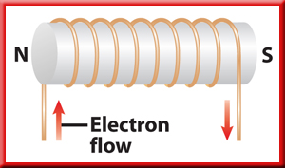
Electricity and Magnetism
8.2
Electromagnets
If the solenoid is wrapped around an iron core, an electromagnet is formed.

Slide 8
Electricity and Magnetism
8.2
Electromagnets
The solenoid’s magnetic field magnetizes the iron core. As a result, the field inside the solenoid with the iron core can be more than 1,000 times greater than the field inside the solenoid without the iron core.

Slide 9
Electricity and Magnetism
8.2
Properties of Electromagnets
Electromagnets are temporary magnets because the magnetic field is present only when current is flowing in the solenoid.
The strength of the magnetic field can be increased by adding more turns of wire to the solenoid or by increasing the current passing through the wire.

Slide 10
Electricity and Magnetism
8.2
Properties of Electromagnets
One end of the electromagnet is a north pole and the other end is a south pole.
If placed in a magnetic field, an electromagnet will align itself along the magnetic field lines, just as a compass needle will.
An electromagnet also will attract magnetic materials and be attracted or repelled by other magnets.

Slide 11
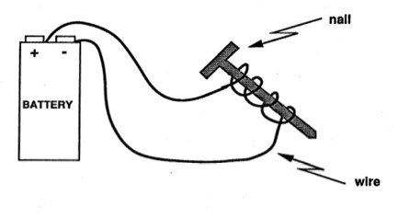
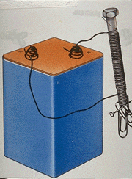
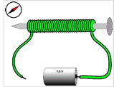
ELECTROMAGNET
A magnet with a field produced by an electric current
Electromagnetism
a moving charge (electricity) produces a magnetic field
More coils of wire= more current = stronger magnet
Bigger battery = stronger magnet
Notes:
What’s going on? An electromagnet is a magnet that can be turned on and off. In this experiment, the battery is a source of electrons. When you connect the wire to the battery, the electrons flow through the wire. If there is not a complete circuit, the electrons will not flow. Electrons behave like little magnets and when they flow through a wire, they create a magnetic field, which turns the nail into a magnet that can pick up paper clips and staples!

Slide 12
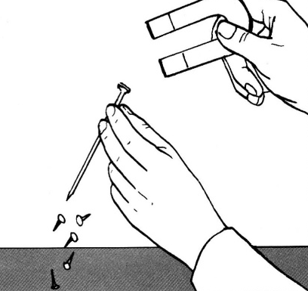
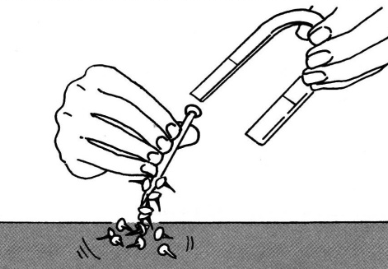
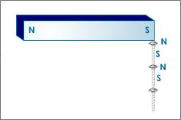
INDUCTION
Causes a response
Example of induction: Making something magnetic
Induction by proximity: putting a magnet on an iron nail induces the nail to become magnetic
Electromagnetic Induction: a moving charge (electricity) through coils around a nail induces the nail to become magnetic

Slide 13
Electricity and Magnetism
8.2
Using Electromagnets to Make Sound
How does musical information stored on a CD become sound you can hear?
The sound is produced by a loudspeaker that contains an electromagnet connected to a flexible speaker cone that is usually made from paper, plastic, or metal.

Slide 14
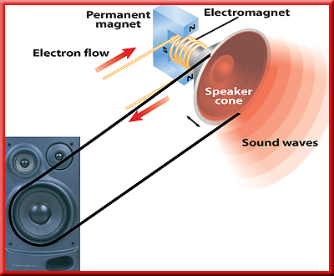
Electricity and Magnetism
8.2
Using Electromagnets to Make Sound
The electromagnet changes electrical energy to mechanical energy that vibrates the speaker cone to produce sound.

Slide 15
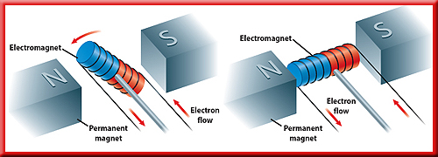
Electricity and Magnetism
8.2
Making an Electromagnet Rotate
The forces exerted on an electromagnet by another magnet can be used to make the electromagnet rotate.

Slide 16
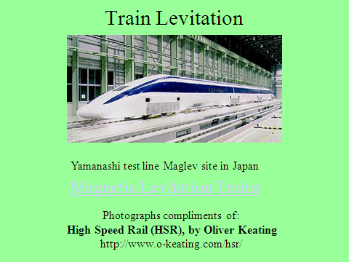

Slide 18
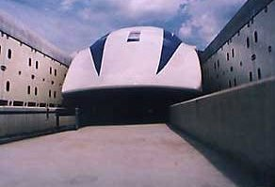
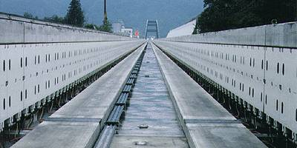
Maglev Train “Tracks”
0
Train moving on
Guideway at 500 mph
The Yamanashi Guideway
for the MLX01

Slide 19
Electricity and Magnetism
8.2
Making an Electromagnet Rotate
One way to change the forces that make the electromagnet rotate is to change the current in the electromagnet.
Increasing the current increases the strength of the forces between the two magnets.

Slide 20
Electricity and Magnetism
8.2
Galvanometers
How does a change in the amount of gasoline in a tank or the water temperature in the engine make a needle move in a gauge on the dashboard?
These gauges are galvanometers, which are devices that use an electromagnet to measure electric current.

Slide 21
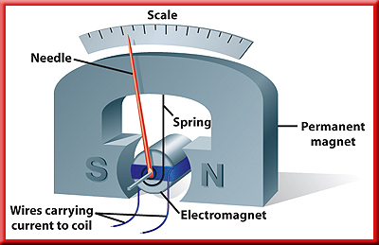
Electricity and Magnetism
8.2
Using Galvanometers
In a galvanometer, the electromagnet is connected to a small spring.
Then the electromagnet rotates until the force exerted by the spring is balanced by the magnetic forces on the electromagnet.

Slide 22
Electricity and Magnetism
8.2
Using Galvanometers
Changing the current in the electromagnet causes the needle to rotate to different positions on the scale.

Slide 23
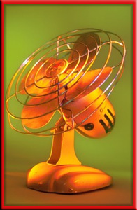
Electricity and Magnetism
8.2
Electric Motors
A fan uses an electric motor, which is a device that changes electrical energy into mechanical energy.
The motor in a fan turns the fan blades, moving air past your skin to make you feel cooler.
Almost every appliance in which something moves contains an electric motor.

Slide 24
Electricity and Magnetism
8.2
A Simple Electric Motor
The main parts of a simple electric motor include a wire coil, a permanent magnet, and a source of electric current, such as a battery.
The battery produces the current that makes the coil an electromagnet.

Slide 25
Electricity and Magnetism
8.2
A Simple Electric Motor
A simple electric motor also includes components called brushes and a commutator.
The brushes are conducting pads connected to the battery.
The brushes make contact with the commutator, which is a conducting metal ring that is split.
The brushes and the commutator form a closed electric circuit between the battery and the coil.

Slide 26
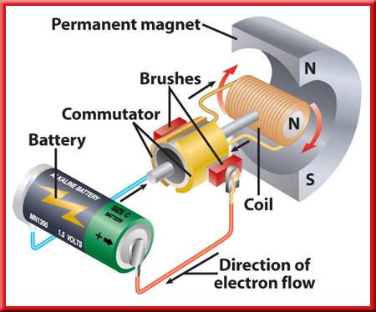
Electricity and Magnetism
8.2
Making the Motor Spin
Step 1. When a current flows in the coil, the magnetic forces between the permanent magnet and the coil cause the coil to rotate.

Slide 27
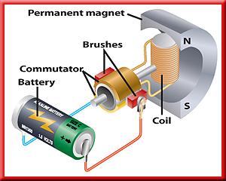
Electricity and Magnetism
8.2
Making the Motor Spin
Step 2. In this position, the brushes are not in contact with the commutator and no current flows in the coil.
The inertia of the coil keeps it rotating.

Slide 28
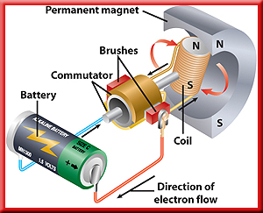
Electricity and Magnetism
8.2
Making the Motor Spin
Step 3. The commutator reverses the direction of the current in the coil.
This flips the north and south poles of the magnetic field around the coil.

Slide 29
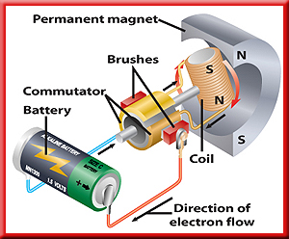
Electricity and Magnetism
8.2
Making the Motor Spin
Step 4. The coil rotates until its poles are opposite the poles of the permanent magnet.
The commutator reverses the current, and the coil keeps rotating.

Slide 30
Section Check
8.2
Question 1
Who correctly hypothesized that electric current produces a magnetic field?
A. Neils Bohr
B. Heinrich Hertz
C. Hans Christian Oersted
D. Max Planck

Slide 31
Section Check
8.2
Answer
The answer is C. In 1820, Oersted hypothesized that electric current produces a magnetic field and that the direction of the field changes with the direction of the current.

Slide 32
Section Check
8.2
Question 2
How can you make an electromagnet?
Answer
An electromagnet is a temporary magnet made by wrapping a wire coil carrying a current around an iron core.

Slide 33
Section Check
8.2
Question 3
Which of the following is a device that uses an electromagnet to measure current?
A. electric motor
B. galvanometer
C. generator
D. transformer

Slide 34
Section Check
8.2
Answer
The answer is B. In a galvanometer, the electromagnet is connected to a small spring.

